Slide 1
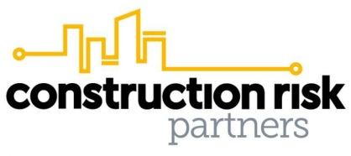
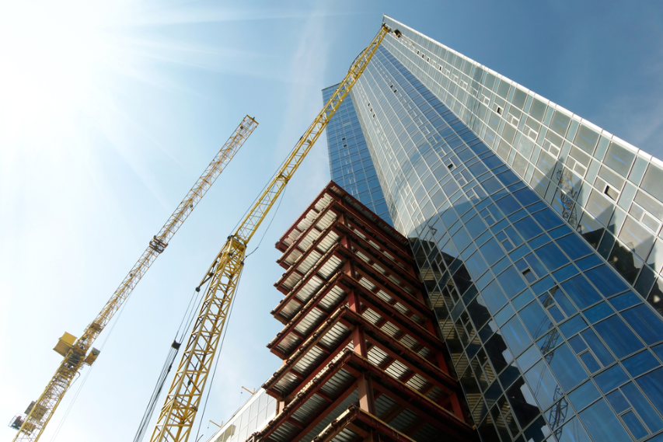
Construction Projects
Risk Management Considerations

Slide 2
Top Project Risks
Economic
Risk
Poor Project Management
Unsafe
Site Conditions
Subcontractor &
Supplier Risk
GL
CEQ
Faulty Work
BR
OPPI
Top
Project
Risks
Auto
SDI
Design Errors
Seasonal &
Weather Risks
WC
Availability
of Quality Labor
CPL
PLL
Cyber
P&P
Theft/Damage to
Building Materials
or Equipment
IDI
Contractual
Risk
Environmental
Risk

Slide 3
Managing Project Risks
Construction Risks | Prevention & Mitigation Strategy
Unsafe Site Conditions | A strong site safety program is essential including proper subcontractor training and orientation. Place equal weight on culture and program. Conduct Jobsite Hazard Analysis to evaluate and prepare for unique site conditions and hazards Consider onsite medical services where appropriate Key Coverage(s): Workers Compensation, General Liability
Theft/Damage to Project, Materials, or Equipment | Invest in proper safeguards including fencing, lighting, sprinklers, security services, and video surveillance. Coordinate with local fire dept and ensure project has proper stand-piping and fire protective equipment. Develop and implement hot work permitting program Develop and implement disaster preparedness and response plan Prepare detailed pro-forma analysis of indirect cost of delay to be properly insured under DSU. Key Coverage(s): Builders Risk, Contractors Equipment
Contractual Risk | Engage legal and risk management advisors to ensure proper contractual risk transfer functions in place. Look beyond the certificate!! Key Coverage(s): General Liability, Environmental Liability, Professional Liability

Slide 4
Managing Project Risks
Construction Risks | Prevention & Mitigation Strategy
Availability of Quality Labor | Proper subcontractor prequalification including manpower capacity. Ensure strong site orientation program and consider resources dedicated to safety and quality control.
Faulty Work | Proper site inspection, quality control and water management program. Consider 3rd party support. Mandate applicable insurance coverage be maintained through Statute of Repose. Maintain proper records for key areas known for potential workmanship issues including site draining, window testing, caulking, waterproofing, and concrete testing. Conduct and Document Post-Completion Inspections starting at 6 months post completion. Key Coverages: General Liability, Builders Risk, Inherent Defect Insurance
Subcontractor Risk | Develop and maintain a robust subcontractor prequalification and selection process. Conduct detailed scope reviews with all key subs Pay close attention to critical path subcontractors Key Coverages: Subcontractor Default Insurance, Performance and Payment Bonds

Slide 5
Managing Project Risks
Construction Risks | Prevention & Mitigation Strategy
Seasonal & Weather Risks | Purchase builders risk insurance on all projects, regardless of size/scope. Both Owner and GC should maintain the right to review the policy in detail. Consider statistical analytics to evaluate proper coverage limits for CAT risks Key Coverages: Builders Risk, Force Majeure
Environmental Risks | Retain certified consulting, engineering, and contracting resources to evaluate and remediate potential presence of hazardous materials. Key Coverage(s): Contractors Professional Liability, Pollution Legal Liability
Design Error | Coordination amongst all key stakeholders and ensure clear contractual obligations between parties. Consider project-specific coverage to ensure limit adequacy and tail coverage. Key Coverage(s): Professional Liability, Protective Indemnity, Rectification
Poor Project Management | Promote proactive dialogue amongst Project Owner, General Contractor, and key subcontractors through all stages of the project including pre-planning and value engineering processes.

Slide 6
Construction Market Trends
Market Dynamics
Market Competition Remains Strong with an Abundance of Capacity on Most Lines of Coverage
Foreign Markets Struggling to Compete with Domestic Carriers on Favorable Risks
Pricing Remains Stable with Continued Expansion of Coverage
  Workers Comp: MA Construction Rates Decreased by 22% in 2018
  General Liability: Modification or Removal of Exclusions J, K, L
  General Liability: Extended Maintenance Coverage Available on Project-Specific Placements
  Builders Risk: Coverage Readily Available for Damage to Faulty Work (LEG 3)
  Builders Risk: Extended Maintenance Coverage Available on Select Projects
  Professional Liability: Often Offering Excess CPL at Little/No Cost
Exceptions to an Otherwise Favorable Market
Commercial Auto
Subcontractor Default Insurance
Residential Projects
Wood-Frame Projects
All Projects in the State of New York
Reduction in Global Capacity / Withdrawal of Several Key London Construction Markets

Slide 7
Construction Insurance Requirements
Project Owner
Property Insurance
Builders Risk
CM
Standard
Workers Comp
General Liability
Auto Liability
Excess Liability
Contractors Equipment
Contractors Pollution
Discretionary
P&P Bond
Subcontractor Default Ins
CCIP
Contractors Professional
Cyber Liability
Crime Insurance
Subcontractors
Standard
Workers Comp
General Liability
Auto Liability
Excess Liability
Contractors Equipment
Discretionary
P&P Bond
Contractors Pollution
Contractors Professional
Cyber Liability
Architect
Professional Liability

Slide 8
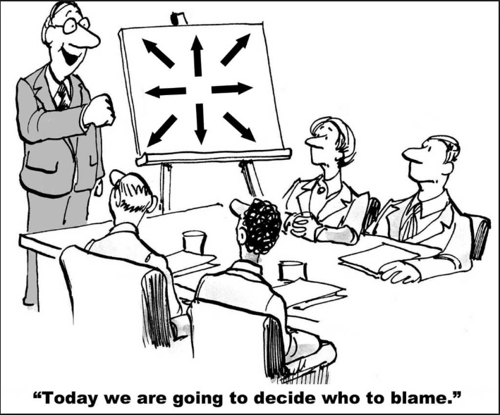
Contractual Risk Transfer
Contractual Indemnity
  Contractual provision that requires one party (Contractor) to Defend, Hold Harmless and Indemnify another party (Project Owner) from Injury or Damage arising out of the work.
Additional Insured Coverage
  Policy endorsement added to the downstream party’s (Contractor) insurance policy that automatically provides coverage for the upstream party (Project Owner) in the event that they incur Injury or Damage that was caused by the Work.
Additional Insured: Common Pitfalls
  Indemnity Trigger
  Work/Operations Trigger
  Contractual Trigger
  Contract Privity
  Contractual Limitations of Liability
  Relationship with Other Insurance

Slide 9
Other Considerations
Owner/Contractor Controlled Insurance Program
  What are the Pros and Cons?
  What Types of Projects are Feasible?
  Who should sponsor the CIP?
Builders Risk Coverage
  Who Should Purchase the coverage?
  What are the Potential Pitfalls to Consider?
Subcontractor Default Insurance
  What is SDI?
  How does it Compare to Bonding?
Owners Professional and Protective Indemnity Coverage
  What is OPPI and Why is it Gaining Traction?
What’s New in the Market?
  Inherent Defect Insurance (IDI)

Slide 10
Wrap-Up Considerations
Consolidated Approach
Sponsor purchases the insurance (called a “Wrap-Up”) on behalf of the project.
“OCIP” = Owner Controlled Insurance Program
“CCIP” = Contractor Controlled Insurance Program
Advantages
Economies of Scale
  Cost Savings
  Tailored Coverage
Minimized Litigation Costs
Cost Certainty Through Life of Project
Coverage Certainty through Statute of Repose
Mitigates Horizontal Exhaustion & Anti-Indemnity Uncertainty
Coordinated Claims & Safety Strategy and Response
Disadvantages
On the Surface, OCIP can be perceived as “more expensive”
Administrative Burden / Internal Resources
Sponsor Assumes Deductible Obligation including Long-Term Collateral Requirements
Monthly Deductible Bill Reviews & Periodic Claims Reviews
CIP
CM
Prime
Prime
Prime
WC
GL
Sub
Sub
Sub
Sub
Sub
Sub
Sub
Sub
Sub
Sub
Excess

Slide 11
Wrap Up Considerations
What Types of Projects Make Sense for a Wrap-Up?
OCIP Feasibility can compare cost of Wrap-Up vs. Traditional Insurance
Typically:
  Stand Alone WC/GL CIP – Projects over ~$100M
  Rolling CIP – Projects over $40M
Projects with Unique Lender Requirements
Projects in States with Challenging Anti-Indemnity Statutes
GL Wraps should also be considered on:
  Commercial projects where the wrap-up sponsor would prefer a smaller deductible ($50k-$100k)
  Residential Projects
  Joint Venture Arrangements
  Projects with contractual risk transfer challenges
Wrap-Ups are also often used by contractors as a way to protect the integrity of their corporate insurance
CIP
CM
Prime
Prime
Prime
WC
GL
Sub
Sub
Sub
Sub
Sub
Sub
Sub
Sub
Sub
Sub
Excess

Slide 12
OCIP or CCIP?
Why Would an Owner Prefer an OCIP?
Owner keeps all generated insurance cost savings
Owner controls insurance program
OCIP can cover work being performed by direct subcontractors outside of the control of the CM
OCIP can cover multi-phase or multi-scope projects involving more than one CM
Owner can pursue transfer of coverage in the event of CM default
OCIPs can protect the owner’s image and provide coordinated public relations response in the event of a catastrophe
Why Might an Owner Prefer a CCIP?
No long term commitment
Less internal resistance
Ability to close-out project accounting upon completion
Push all administration down to the CM
Can still negotiate savings over traditional insurance up front
CIP
CM
Prime
Prime
Prime
WC
GL
Sub
Sub
Sub
Sub
Sub
Sub
Sub
Sub
Sub
Sub
Excess

Slide 13
Builders Risk Coverage
What Does the Current Market Look Like?
Slower to react to recent CAT activity compared with Commercial Property Market
Domestic Rates Continue to Drop While Coverage Expands
London Market Shrinking
Rise in Wood Frame Construction Projects
What Are Potential Coverage Issues?
Delay / Soft Costs
“ATIMA”
Temporary Structures
Scope of Coverage for Faulty Workmanship / Faulty Design
Existing Building Coverage
Beware of the “Button Up Clause”
Warranty Conditions
Damage to Contractors Equipment & Time-Element Exposure
When Does Coverage Terminate?
Ensuing Loss from Wear & Tear
Trouble on the Horizon??

Slide 14
Builders Risk Coverage
Who Should Purchase the Policy?
Advantages of an Owner Placement
Full Transparency on Premium Costs
Certainty that premium has been paid
Extended Payment Terms
Coordinated Interface with Operational Policies
Owner controls policy terms and conditions
Dedicated Limits to the Project
Owner controls claim process
Ability to purchase/adjust DSU exposure
Ability to tailor coverage to meet lender requirements
Advantages of a Contractor Placement
Contractor has optimal market leverage
Owner maintains no deductible exposure
Contractor can address potential coverage overlap with other policies (GL, Professional, etc.)
Contractor has experience managing these claims
Master Builders Risk (MBR)s provide:
  Economies of Scale
  Long-Term Rate Certainty
  More favorable cancellation provisions
  Often broadest market coverage
Contractor can still:
  Add Owner as Named Insured and Loss Payee
  Purchase DSU
  Interface with Owner’s operational policies
  Meet Lender Requirements

Slide 15
Subcontractor Default Insurance
What is SDI?
An insurance policy that indemnifies an Insured (the Construction Manager) against the financial cost of a subcontractor defaulting on their contract.
SDI
Construction Manager
(Insured)
Construction Manager
Subcontractor
(Principal)
Surety
Subcontractor
Surety
SDI

Slide 16
Subcontractor Default Insurance
How is the Policy Structured?
Can Project Owner Make a Claim to a Contractors Policy?
The policy can be endorsed to allow Owner/Lender to make a claim but only when Insured has been terminated for insolvency
Risk Transfer
Per Occurrence Limit
Policy Aggregate Limit
Aggregate
What are the Benefits to the Project?
Allows for Timely Completion of the Project
Shifts Control of the Remedy to the Contractor
Cost is Comparable to Subcontractor Bonding
Promotes Better Subcontractor Prequalification
Broader Coverage than a Surety Bond
  Covers all Subs on the Project
  Default = Coverage (not terminate)
  Coverage not limited to amount of contract
  Covers Long Term Warranties
  Covers both Direct and Indirect Costs
Co-Payment Layer
Deductible
Can the Owner buy SDI?
Not unless the owner is holding direct subcontracts and maintains a comprehensive prequalification process

Slide 17
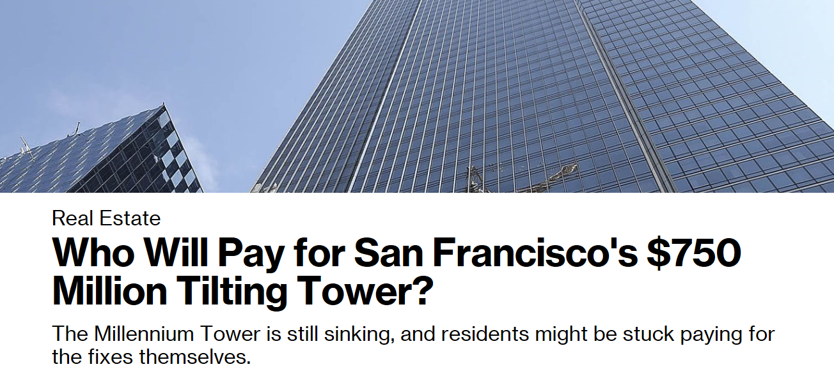
Owners Professional Protective
What is OPPI?
A professional liability policy that provides two primary coverages:
Third Party Liability arising out of acts, errors, or omissions of architects, engineers, and other design professionals
Contingent (“Protective”) insurance that sits atop insurance provided by the architects, engineers, and design professionals’ insurance
Why is it Gaining Traction?
Consider a typical $100M Construction Project:
General Liability Insurance Provided by the GC/CM: ~$50M-$100M
Professional Liability Insurance Provided by the Architect: ~$5M
$10M OPPI Coverage can cost as little as 0.1%

Slide 18

Inherent Defect Insurance
What is IDI?
A first-party policy that covers latent defect due to faulty design, faulty workmanship, or faulty materials.
Why is it Gaining Traction?
Provides 10-12 years of coverage post-completion
Not Negligence Based
Reduces exposure to General Liability & Professional Liability
Insulation from Risk of Contractor Insolvency or Risk Transfer Challenges post-completion
Value Enhancement / Freely Assignable
Related Entities
Lender Requirements

